Slide 1
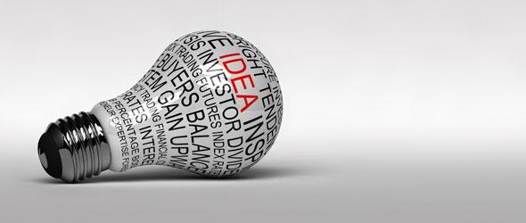
Design Concepts
Underlying good communication
Notes:
Presentation about some key Design Concepts we can use when learning Photoshop

Slide 2
The Reason Why
“Design is not just what it looks like and feels like. Design is how it works”
The key concepts behind design help communicate a message clearly and attract attention
They reinforce ideas
Notes:
There are key concepts behind design that have as much to do with communicating a message clearly as they do with attracting attention. In graphics we rely on a common knowledge of these concepts to help us design a visual message that will get the attention of the right audience. These concepts also allow us to communicate ideas with fewer words, or to reinforce ideas that are present in text.
The key use of these elements for you as we go through this unit is to grab attention. You want people to look at your work so you can communicate your message. You will want to create tension in your work, whether it is through difference in size, contrast or colour, in order to create an image that will catch the viewer and draw them into your image.

Slide 3
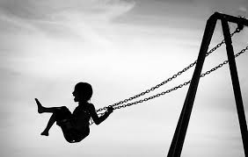
Contrast
Relies on difference in some element
It draws attention and makes something memorable
Notes:
Contrast relies on differences. We have many different types of contrast. It can be contrast in size, colour, lightness, or just about anything on the page that sets up a difference between elements. The key thing to remember is when contrast is used properly it attracts attention. That is a good thing for you as a designer because you are trying to attract viewers.

Slide 4
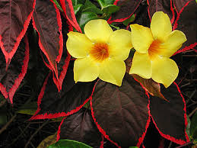
Colour
Easy to manipulate
Creates contrast
Can evoke emotion or deeper meaning
Notes:
Colour is one of the key things you can manipulate. When you use it well you can create eye catching contrast that will direct the viewer’s eyes to parts of the page. Colour also has added meaning. Red and orange usually create a warm feeling while blue and green are usually cool and soothing. Always be considerate when choosing a colour for your work.

Slide 5
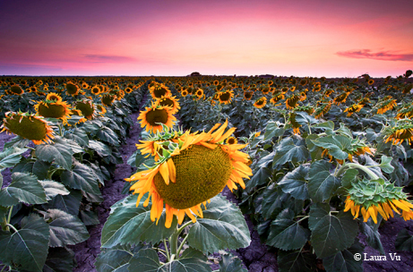
Size
Larger objects draw attention
Also creates contrast
Creates a hierarchy (makes things important)
Notes:
Size is another way to grab attention and create contrast. When you enlarge objects in an image it will draw attention to them. You can reverse the concept to make things insignificant by making them small. Also remember the more important something is the bigger it should be. This becomes significant when you work with type and fonts.

Slide 6
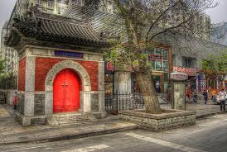
Balance
Creates a relationship between objects on screen
Unbalanced scenes are called asymmetric
Balance can direct attention
Notes:
Balance has to do with how your objects relate to each other on the page. When things are unbalanced, which is also called asymmetric, it tends to create tension and grab attention. However, that doesn't mean you will never create a graphic that is balanced. There will be a time when you will want to create one. Know why you are doing it and how it helps grab attention.

Slide 7
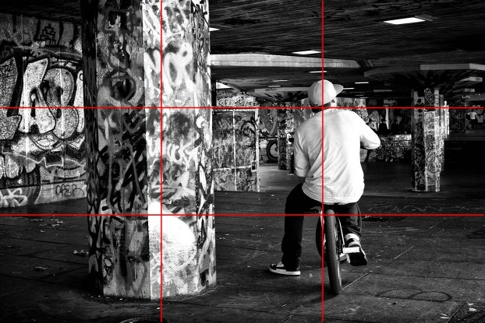
Rule of Thirds
Divide the screen into horizontal and vertical thirds
Place key elements on those lines
Creates and interesting scene
Notes:
The rule of thirds has been around for a long time And is present in all visual arts. At its core, it keeps you from placing things in centre of the page, which keeps you from creating a mundane image. You divide the image into thirds, both vertically and horizontally. This creates an imaginary grid on the page with four points where the lines intersect. When composing an image, you place key elements near these points of intersection to start building a more interesting image.

Slide 8
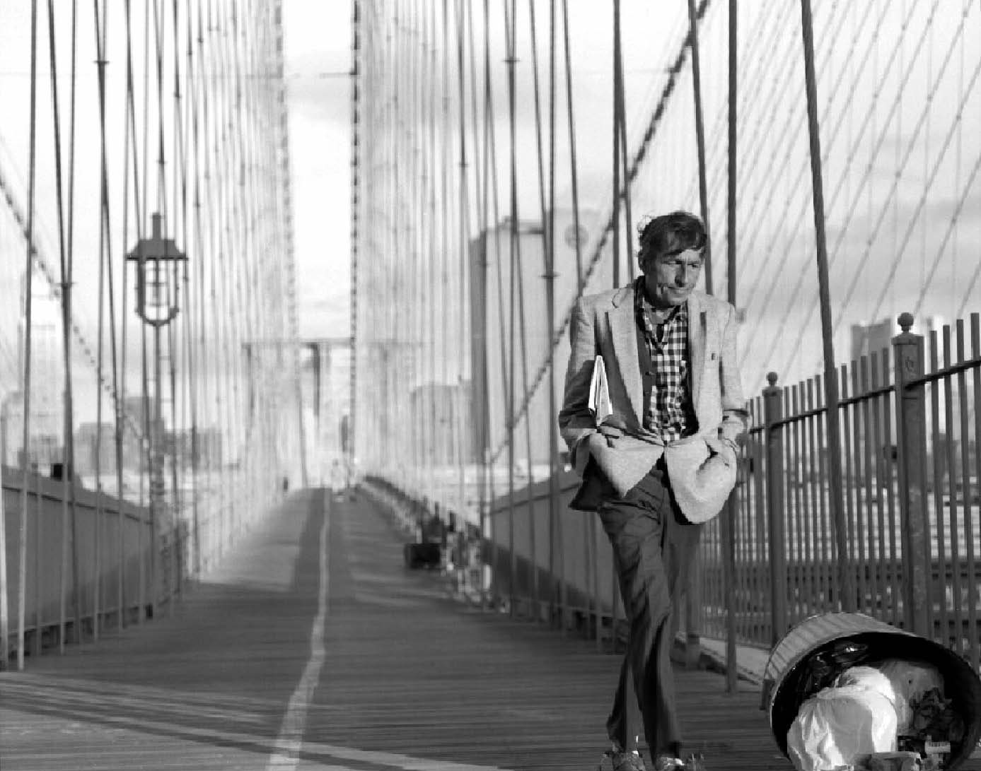
Background / Foreground
Gives image dimension
Places the main point of interest in space
Can give additional meaning to image
Notes:
Adds a third dimension to your image. It lets you place your subject (the main element in your graphic) within the page, and give it a sense of place or size. You can use it to add additional meaning to your work, by creatively placing elements in the image that are significant.

